Slide 1
Examining Uranium Geochemistry in the 1.64 Ga Barney Creek Formation
Quinn R. Shollenberger
April 21, 2012
Notes:
Hi! My name is Quinn Shollenberger and I am a sophomore studying chemistry in the Department of Chemistry and Biochemistry at Arizona State University. Today, I would like to introduce to you and explain my project along with our results. My topic is examining uranium geochemistry in the 1.64 billion year old Barney Creek Formation.

Slide 2
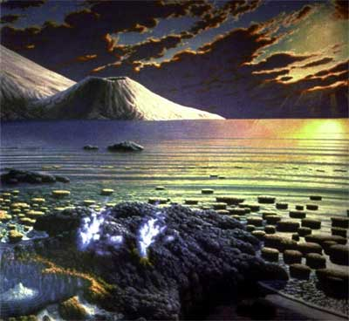
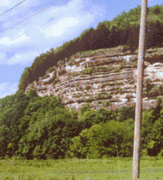
Motivation
?
Notes:
In order to understand my topic, I’d like to give some background information on the Earth and its time periods. Shown are three of the four most recent eons of Earth’s history. The environment and chemistry of the oceans is very different in each. The three time periods are the Archean, Proterozoic and Phanerozoic. My research examines the Proterozoic. The Proterozoic spanned from 2.5 billion years ago to 542 million years ago. During this time there were eukaryotic cells, a build up of oxygen, and animals emerged at the very end of this time block. The reason I am looking at the Proterzoic is because it is the time period we know the least about.

Slide 3
Paleobiogeochemistry
Lyons et al., 2009, Courtesy of Amy Kelly
Notes:
Shown here are oxygen levels in the atmosphere and deep ocean chemistry plotted against time with important evolutionary events highlighted. The amount of oxygen in the atmosphere has increased significantly over time. The biggest increase came at the Great Oxidation Event. Over time, the chemistry of the oceans has changed dramatically. The three main types of ocean chemistry include oxic, euxinic, and ferruginous. Oxic is exactly what it says, containing oxygen. This is the most recent type of ocean chemistry. Euxinic and ferruginous environments both lack free oxygen. Ferruginous environments contain free reduced iron and this type of environment can be most noticeably observed almost 4 billion years ago. The time period we are looking at, the Mid-proterozoic, is highlighted in purple. During the proterozoic, we believe parts of the ocean was euxinic including shelves and isolated basins. Euxinic is an environment with free sulfide in the water column. However, the extent of euxinia during the proterozoic is questionable and that is why we are examining samples from the McArthur Basin. The McArthur Basin is an example of a euxinic water column from the mid-proterozoic. Different proxies all combined can help us determine potentially how extensive euxinia was in the global ocean at this time.

Slide 4
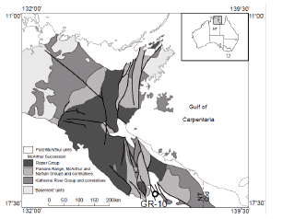
McArthur Basin
Barney Creek Fm. 1.64 Ga
Davidson and Dashlooty, 1993, Courtesy of Amy Kelly
Notes:
To examine the deep ocean chemistry during this time, a postdoctoral scholar from our lab group collected samples from the GR-10 which is located in the McArthur Basin in northern Australia. The GR10 is a drill core with rocks from the Barney Creek Formation.

Slide 5
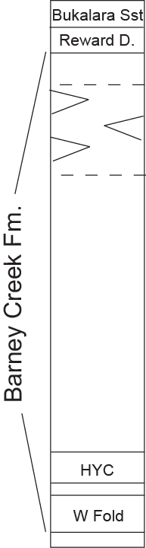
Stratigraphy
turbidite
slump
breccias
Davidson & Dashlooty, Aus. J. Earth Sci. 1993; Courtesy of Amy Kelly
Notes:
The GR10 samples are from the Barney Creek Formation, which is a part of the McArthur Group. Shown to the right is how the Barney Creek Formation is broken down. The Barney Creek Formation contains three units of rocks, all of which are represented in our samples: the W-Fold shale, HYC- Pyrite Shale, and what are simply referred to as upper units. Turbidite slump breccias are found here in the upper units. Turbidites are deposits of sediment from the land that are transported and deposited into the oceans. Therefore, they do not inform about the chemistry of the oceans.

Slide 6
Proxies on the GR10
Notes:
Various proxies have been done on the GR10 to show evidence for euxinic conditions during the Mesoproterzoic. The proxies can be divided into two categories, organic and inorganic. Organic studies on this core used things such as biomarkers to check for euxinic conditions. An inorganic proxy done on this core was degree of pyritization. I hope by examining the uranium isotopes, another inorganic proxy, more evidence will show the basin was euxinic.

Slide 7
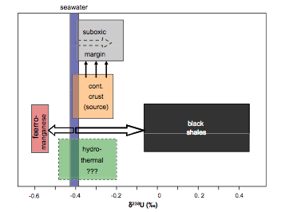
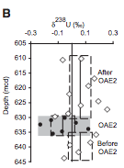
Why look at the Uranium Isotopes
Weyer et. al 2008
Montoya-Pino et al. Geology. 2010
Notes:
Examining the Uranium 238 to Uranium 235 ratio, is another redox indicator that can be used to test whether the oceans were mainly euxinic during the mid-proterozoic or at least in our sub-basin. It has been shown that uranium is reduced and becomes more isotopically heavier, meaning it has a greater concentration of U238, in an anoxic environment. Black shales are generally deposited in anoxic environments. This means the Uranium 238 to Uranium 235 ratio in the remaining ocean waters would be light. Therefore, this would be an indicator that the ocean was euxinic. Also, uranium accumulated under anoxic but non-sulfidic conditions tends to be lighter than uranium accumulated under euxinic conditions. The Weyer figure shows the natural fractionation of U238 to U235. Black shales are clearly distinct and occur around -0.1 to 0.4 compared to seawater. This indicates that black shales in reducing environments are isotopically heavy. An interesting study by Montoya-Pino et al. showed for sediments deposited during an oceanic anoxic event in the Mesozoic, which is when global oceans became mildly anoxic, that the sediments are low in ²³⁸U. Since the isotope signature is light this means there are more basins with heavy uranium. However before and after the oceanic anoxic event we can see the sediments had higher ²³⁸U values. These studies support the use of ²³⁸U/²³⁵U ratio as another proxy to inform about the chemistry of the oceans.

Slide 8
Sources of Uranium in Shales
Notes:
For any shale there can be three sources of uranium. These sources include authigenic meaning uranium in the water, Uranium from carbonates, and detrital is the uranium from the land. We are interested in the authigenic uranium. However, only shales that have uranium concentrations greater than 10ppm can we get a true authigenic signal. Authigenic uranium accumulated under anoxic but non-sulfidic conditions tends to be lighter than uranium accumulated under euxinic conditions.

Slide 9
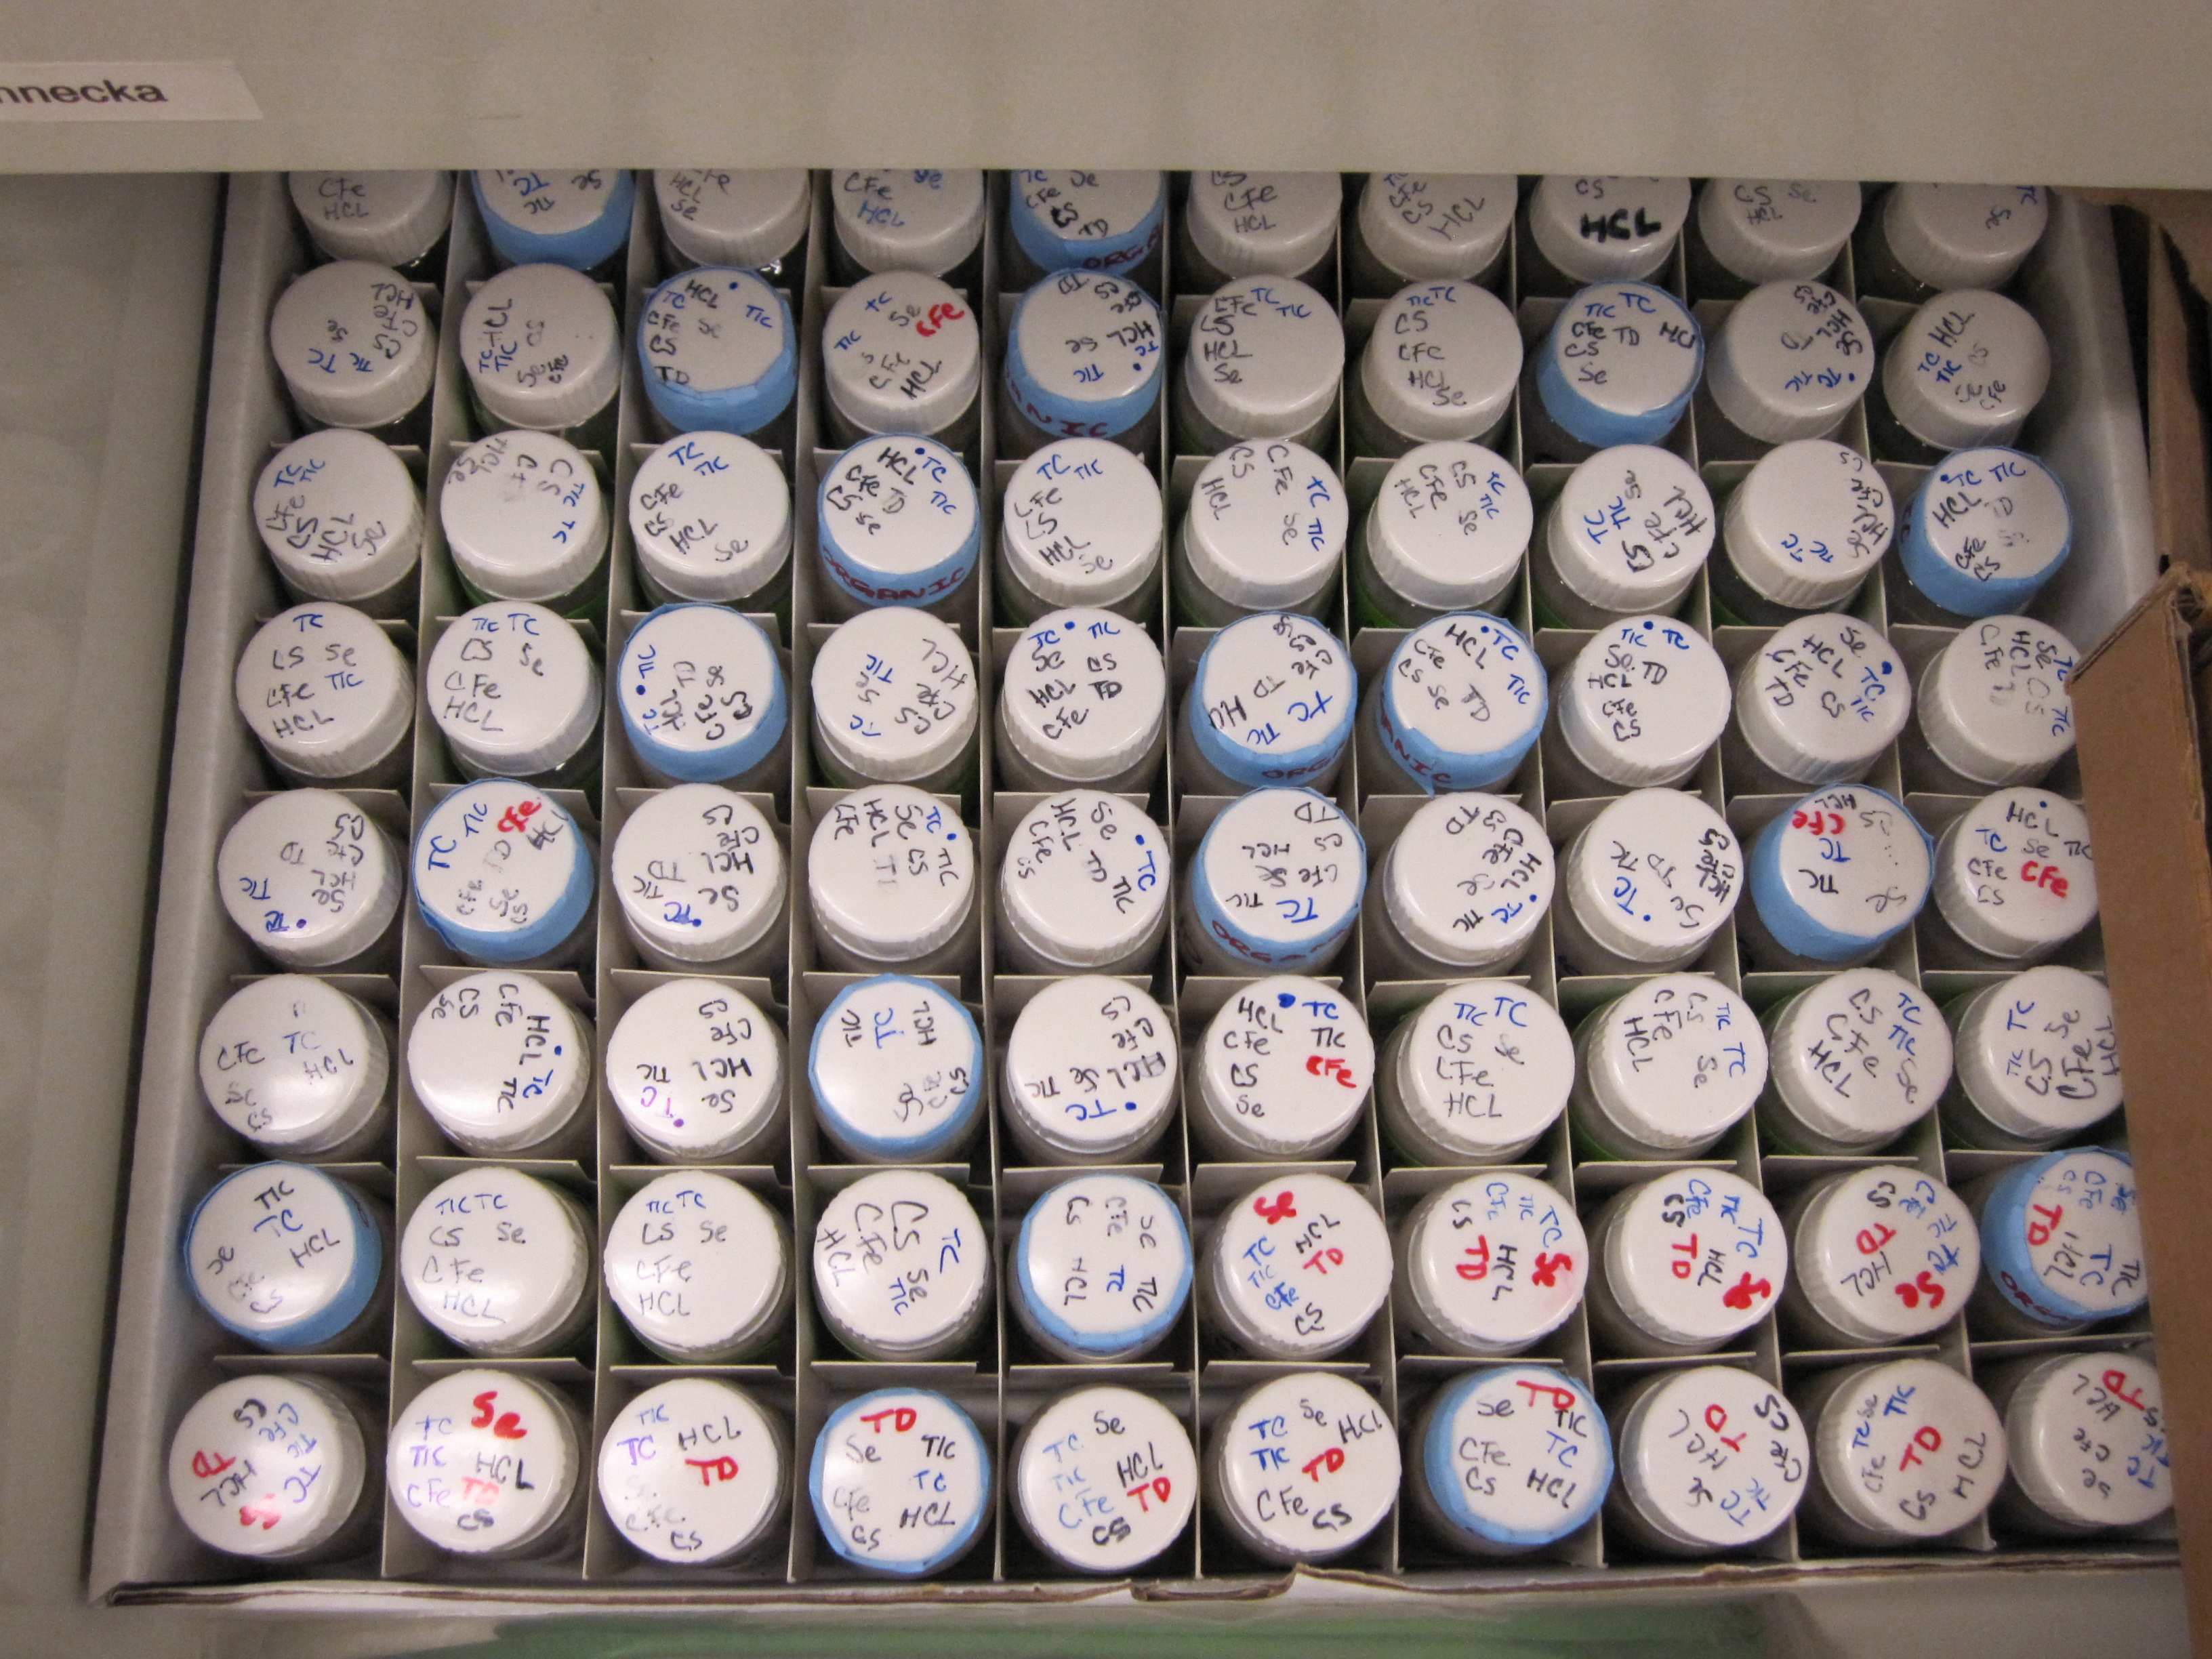
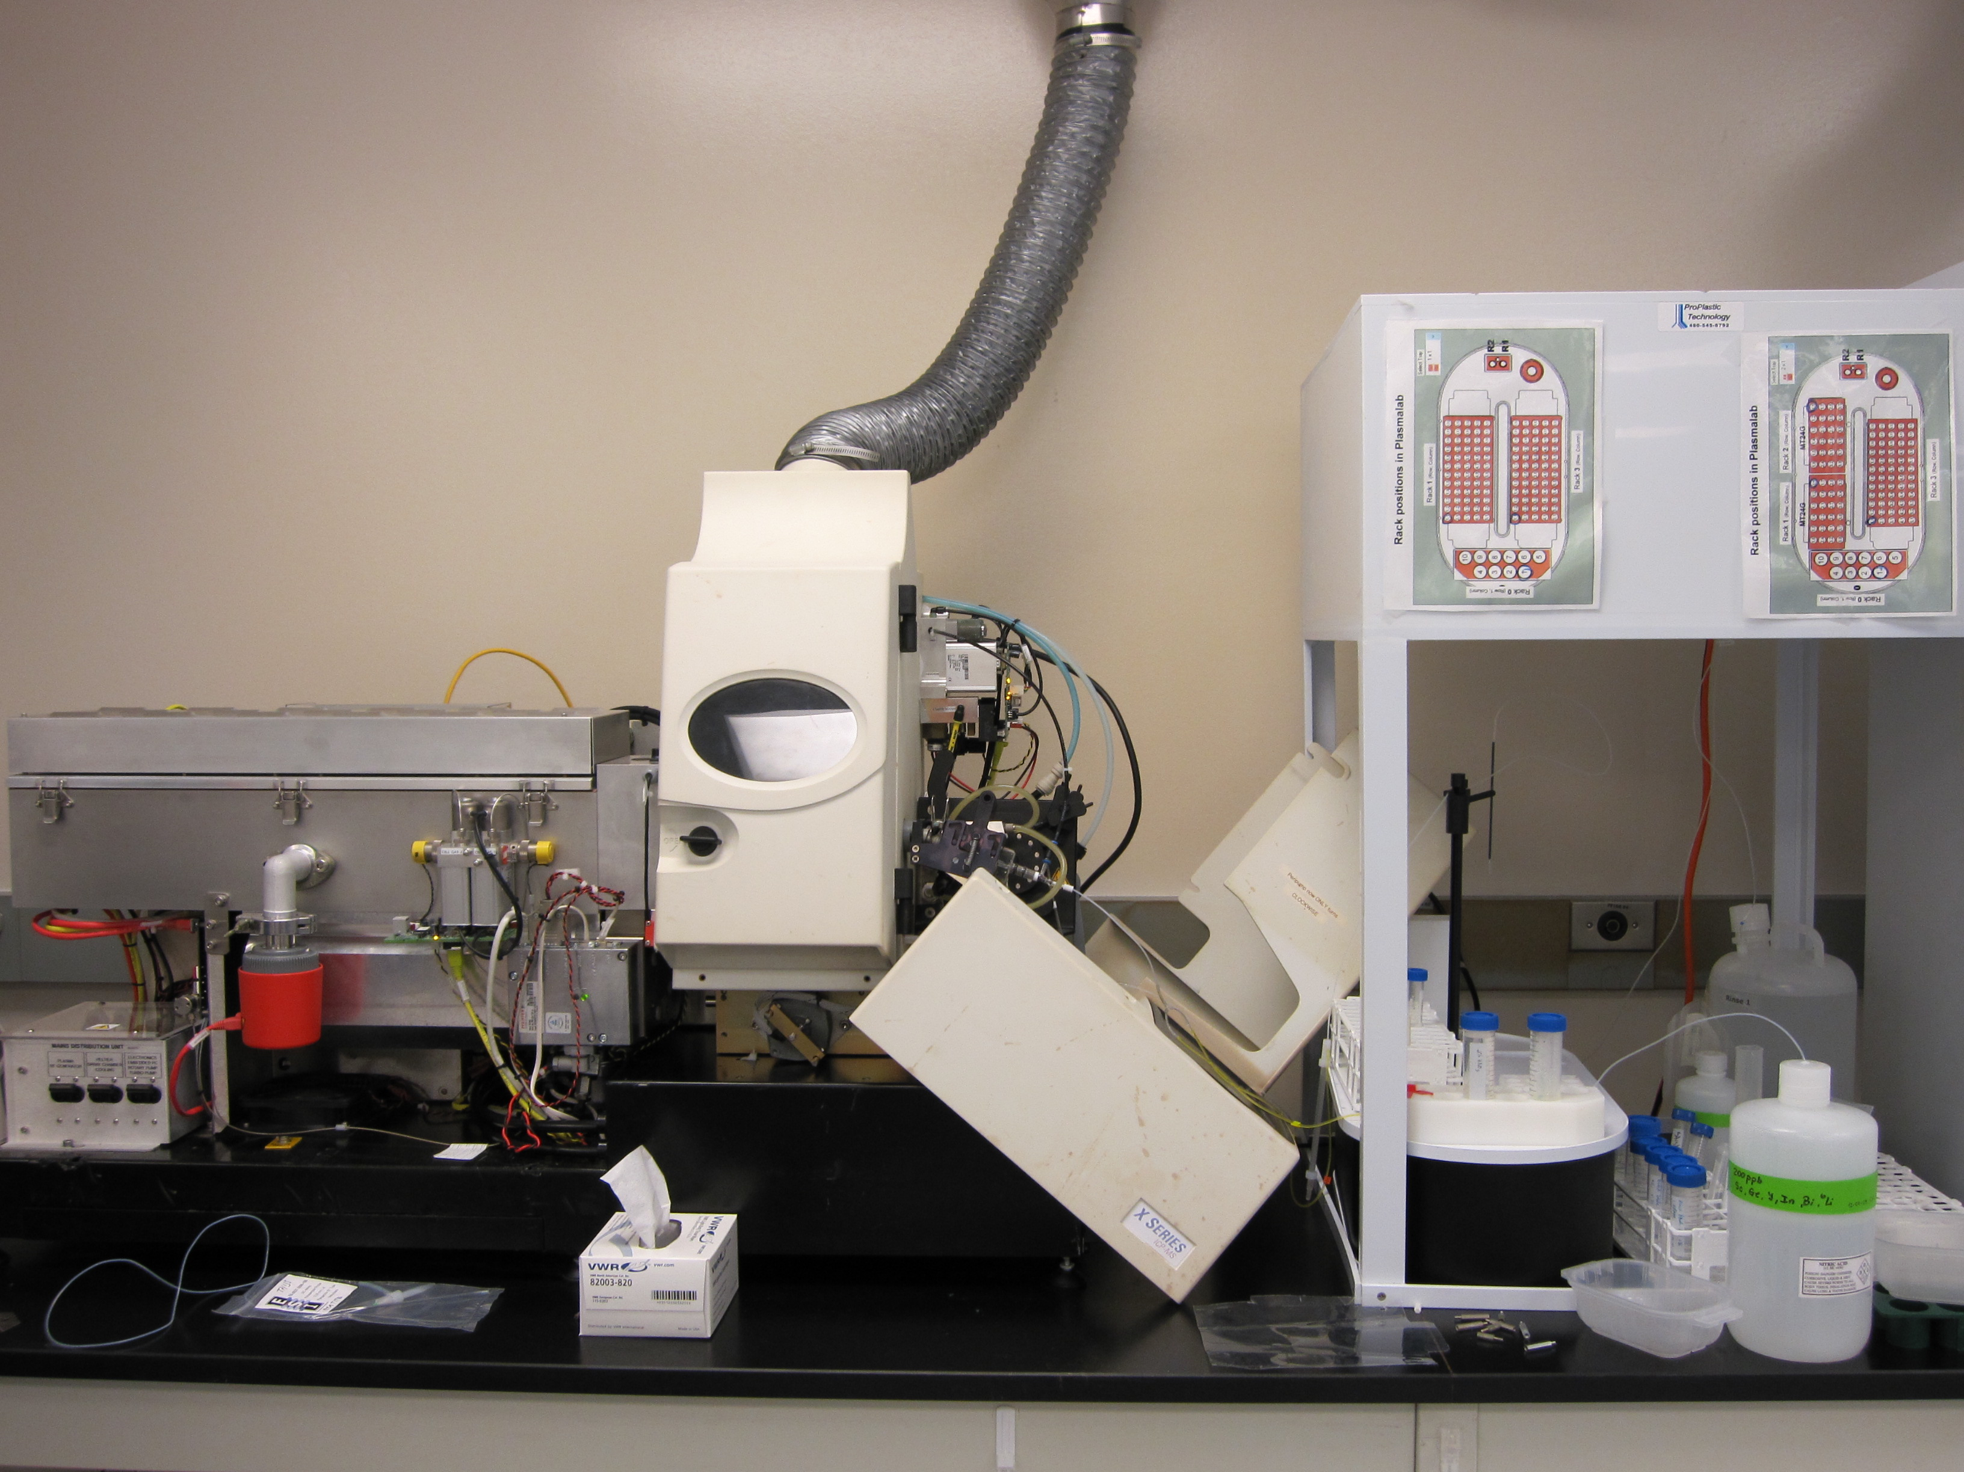
Methods
Notes:
As I have said before, a postdoctoral scholar from our lab group went to the McArthur basin in Australia and collected 109 samples from the GR10 core in the Barney Creek Formation. All three units of rock are in these samples including the W fold, HYC pyrite, and upper unit rocks. Each sample was heated in the furnace to remove all of the organics from the rocks and then went through a digestion process of adding a sequence of acids and heating in the trace metal clean lab. The samples were digested into a liquid form. The samples were run on the Thermo Scientific X-Series Quadrupole Inductively Coupled Plasma Mass Spectrometer to check the total concentrations of the metals, specifically for me the concentration of uranium.

Slide 10
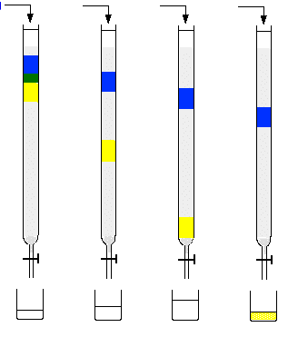
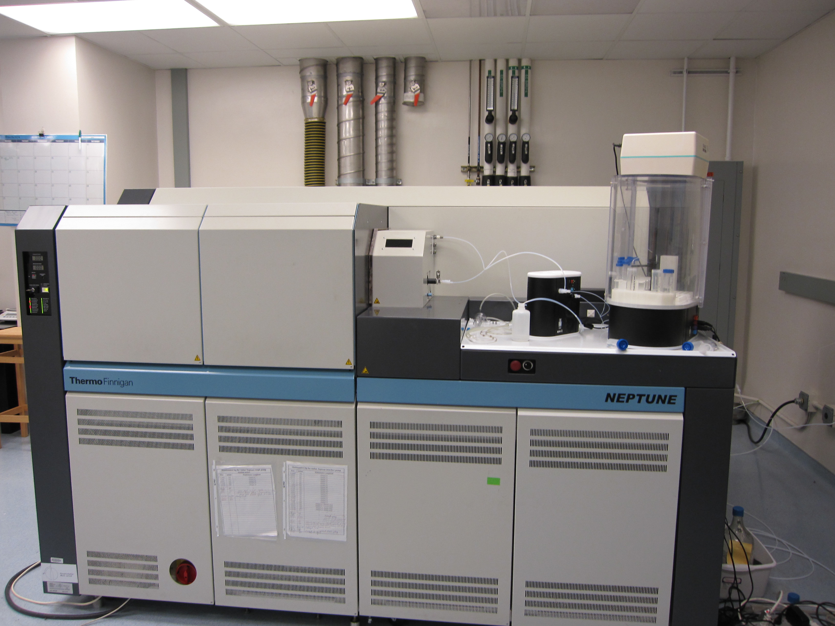
Methods
Notes:
At the start of this fall 2011 semester, I began column chemistry on the samples. Column chemistry involves getting rid of all the metals in the sample besides uranium so I can properly look at the uranium ratio. I spiked the samples in order to account for mass biases in the Neptune Multi Collector-Inductively Coupled Plasma Mass Spectrometer. The samples were doubled spiked before being ran through the columns. The sample was added to ion exchange resin in nitric acid which kept the uranium and thorium in the column. Then hydrochloric acid and oxalic acid were added to remove the thorium. Final the uranium comes through the column along with some organics from the resin by adding hydrochloric acid. After column chemistry, peroxicid was added to the samples to remove the organics and then the samples were dried down and were prepared for the Neptune. Then the samples were processed on the Neptune. This machine is a multicollector that has the ability to measure element ratios.

Slide 11
Predicted Results
Reduced Environment
Light Uranium Isotopes
δ²³⁸U
- ____________________→ + Modern
Ocean ____________________→ Black Shale
-0.4 0.2
Mesoproterozoic Ocean ____________________→ Black Shale
-1.0 -0.4
Notes:
We hypothesize that our results will show us a light uranium isotope ratio. If the global ocean is reducing as we think, then heavy uranium will be deposited in many basins, leaving the global uranium isotopic composition light. Since the McArthur Basin may be a more extremely euxinic basin than the global ocean at this time, we may see a heavy isotopic signature compared to the global signature at the time, but I expect to see a light ratio relative to modern euxinic basins. This would agree with our hypothesis that the ocean during this time was euxinic. For example, if our predicted results show the uranium ratio value to be -0.4. If the factor of 0.6 stays the same as in the modern euxinic body of water than our predicted uranium ratio value for the ocean is -1.0. This proves that the uranium was being reduced much more than today and indicating the global deep ocean was euxinic.

Slide 12
Uranium Concentrations and EF
GR10 537.90 GR10 603.64
Courtesy of Amy Kelly
Notes:
The results of the Uranium Concentrations and uranium enrichment factors are shown. Yellow represents samples from the turbidite layer. Pink shows samples from the basin and the rest are unknown because they were not measured for organics. The samples from the top of the core look do not match up and we are still unsure why this is. Only GR10 537.90 and GR10 603.64 have uranium concentrations greater than 10ppm. The enrichment factor is the ratio of U/Al in our samples versus the U/Al of an average upper crustal shale. This ratio is important so we can accurately compare samples. There can be a lot of uranium in sample because it truly contains that much uranium or there can be a lot of uranium because of rapid deposition. This ratio cancels out the rate of deposition allowing us to accurately compare samples. Once the depositional rates are canceled out in the EF, samples 537 and 603 still have the most uranium.

Slide 13
Uranium Isotope Results
Courtesy of Amy Kelly
Notes:
Shown are the results from the Neptune with the symbols staying consistent with the last slide. Remember GR10 537 and GR10 603 are the only ones with U concentrations greater than 10ppm. This means they are the only ones that could give an accurate value for the isotopic value of authigenic fraction. GR10 603 is euxinic from iron speciation and its delta value is -0.07. The rest of the samples suggest euxinic conditions since they are also light. However, these samples do not definitely suggest euxinic conditions because their concentrations were less than 10ppm. Keeping the standard offset, we would expect the ancient ocean to have had a d238U value of -0.7. This suggests along with the other proxies that a greater extent of the ancient ocean was euxinic compared to today. However, we did face some problems with spiking the samples. Some samples had too much spike and had to be disregarded.

Slide 14
Final Conclusions
Clear evidence for euxinic conditions in the water column
Ancient ocean δ²³⁸U = -0.7
To do
Notes:
Sample 603 shows clear evidence for euxinic conditions in the global ocean during the proterozoic. All the other samples also suggest euxinic conditions. We expected to see a light uranium ratio indicating the global ocean was reducing and indeed this was observed. Our results showed a value of around dU238 -0.7. However, some of our samples do not match up and this needs to be re-examined. We see hydrothermal influences with GR10 603 having nearly 400 ppm Zn and 70 ppm Pb and we're not sure how that affects our interpretation. These are the only measurements for the whole Proterozoic of uranium isotopes. In conclusion, examining uranium isotopes was successful in confirming evidence for euxinic conditions in the ancient ocean during the mid-Proterozoic. We have planned to re run sample 603 since its spike ratio was off. Other samples will also be run to account for the errors in the samples that were mis spiked.

Slide 15
Acknowledgements
Advisors
  Ariel Anbar
  Amy Kelly
Funding
  NASA Space Grant Program
Notes:
I’d like to thank my advisors, Dr. Ariel Anbar for allowing me this opportunity to work with the lab group and assist with funding for this project. I’d like to thank post-doctoral scholar Dr. Amy Kelly for all of her help with this project and for being my mentor on the project. I’d finally like to thank NASA Space Grant program for funding this project.

